Slide 1
Media & Technology
Project-1
By Mehnaz Shafeek

Slide 2
Abstract
This project aims to explore and analyze the relationships and patterns between various variables in the given dataset. The dataset provides valuable insights into features such as YouTubers, their countries of origin, creation dates, subscriber counts, YouTube income, and more. This presentation summarizes the key observations and conclusions derived from the dataset, offering a comprehensive understanding of the trends and correlations within the YouTube ecosystem.

Slide 3
Data visualisation
Libraries used are:-
Mathplotlib
Seaborn
Numpy
Pandas

Slide 4
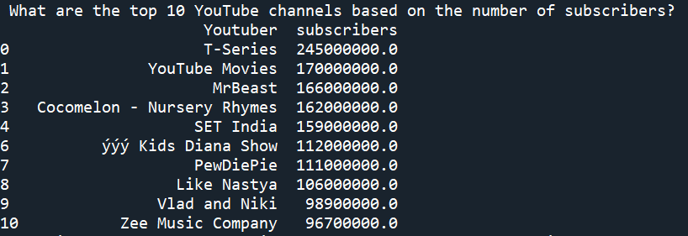
Top 10 YouTube channels based on the number of subscribers

Slide 5

Which category has the highest average number of subscribers?

Slide 6
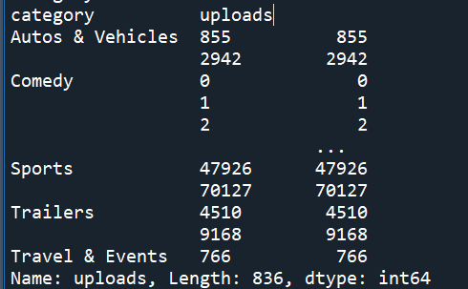
How many videos, on average, are uploaded by YouTube channels in each category?

Slide 7
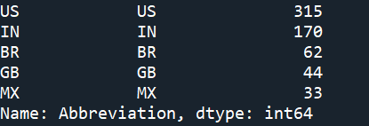
What are the top 5 countries with the highest number of YouTube channels?
United States,India,Brazil,United Kingdom and Mexio are countries with the highest Youtube channels

Slide 8
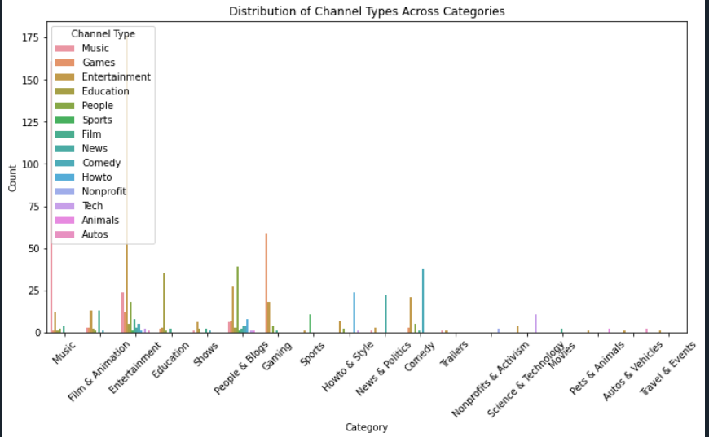
What is the distribution of channel types across different categories?
Inference:-
As you can observe , Film and animation category possess the highest amount of channels followed by music then people and blogs cat.

Slide 9
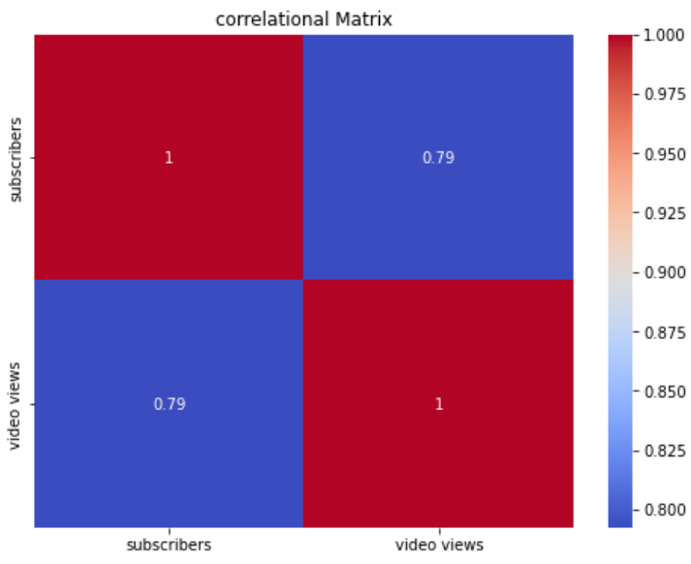
Is there a correlation between the number of subscribers and total video views for YouTube channels?
The correlation coefficient between subscribers and video views is 0.79.
This indicates a strong positive correlation between the two variables.
A higher number of subscribers generally correlates with higher video views,
but the relationship is not perfect (since the value is below 1).

Slide 10
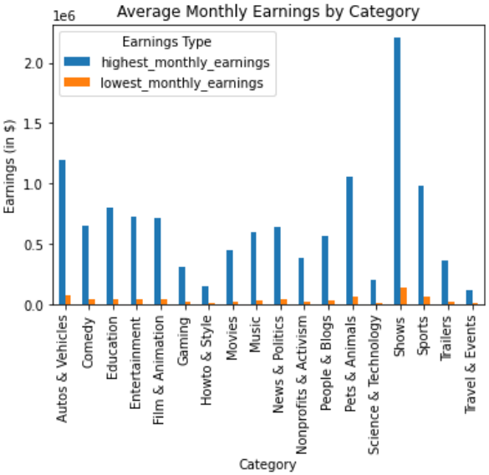
How do the monthly earnings vary throughout different categories?
Monthly earrings is the highest for ‘Shows’ and least for ‘Travel and Events’.
This shows that people engage in shows,autos and vehicles content more and least in Travel and Events

Slide 11
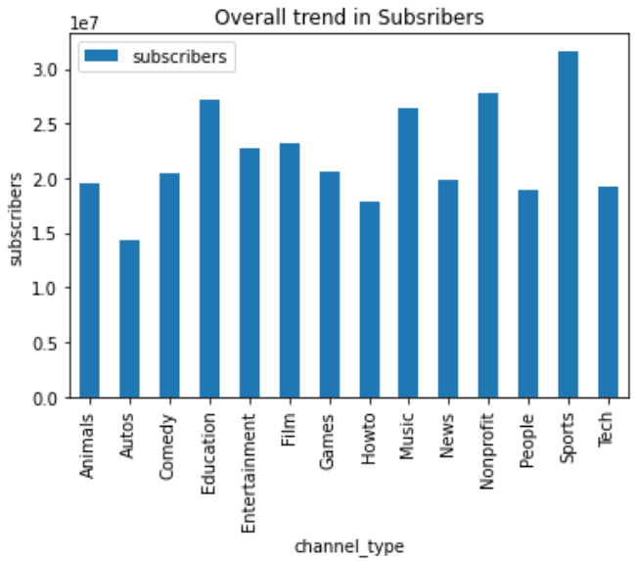
What is the overall trend in subscribers gained in the last 30 days across all channels?
In the last 30 days, Sports category has gained the highest subscribers.

Slide 12
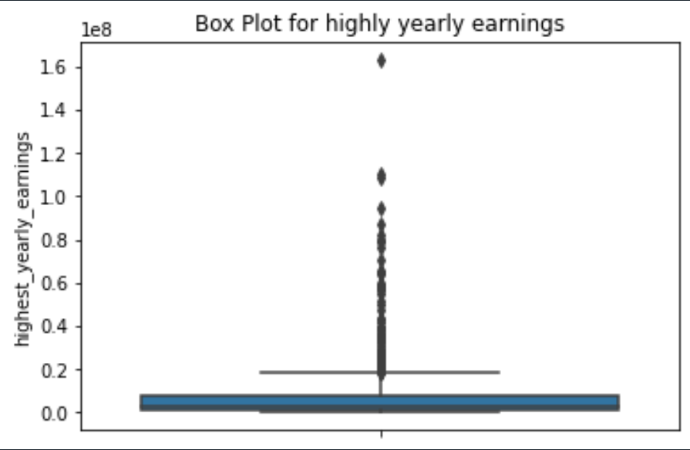
Are there any outliers in terms of yearly earnings from YouTube channels?
Few individuals are earning significantly than the others.
All the dots represent outliers.
These indicate that there is gap between majority of earners and a small group high income earners.

Slide 13
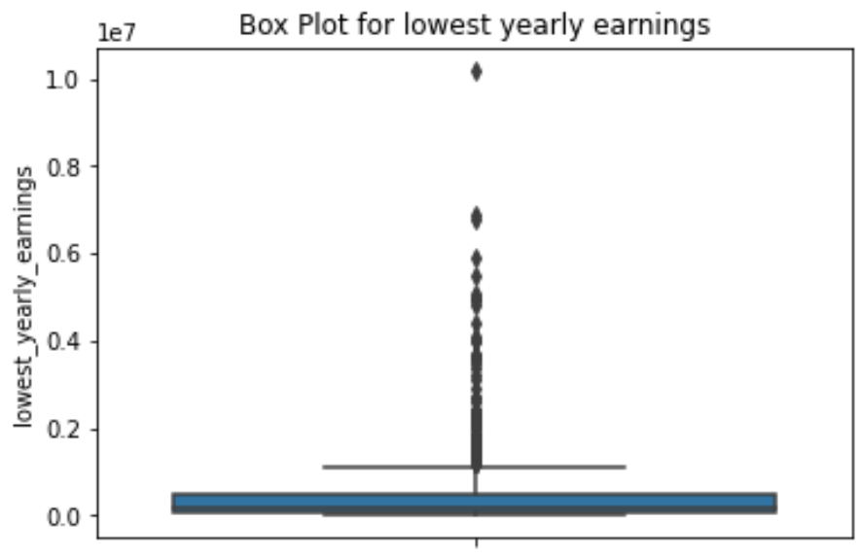
Are there any outliers in terms of yearly earnings from YouTube channels?

Slide 14
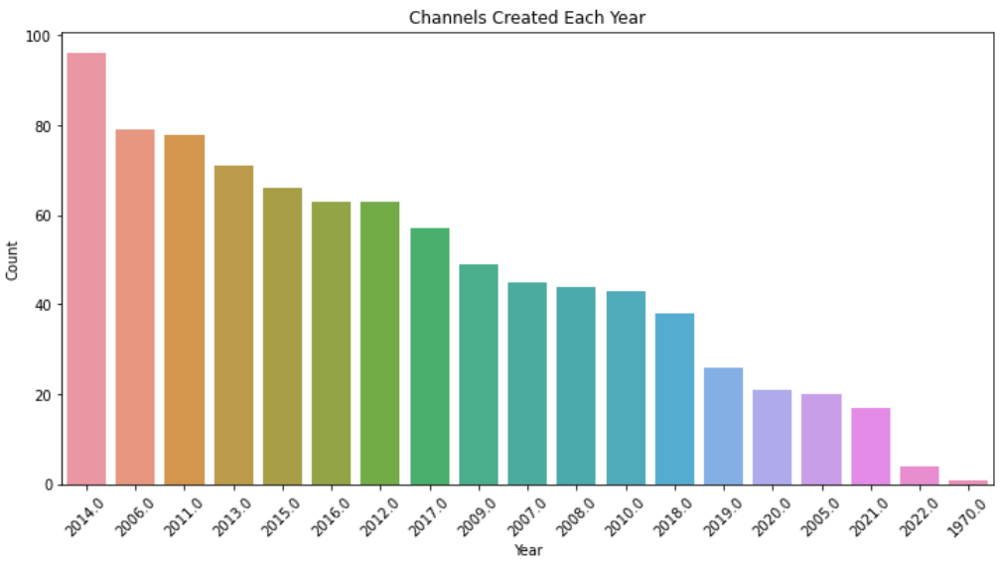
What is the distribution of channel creation dates? Is there any trend over time?
From 2005 to 2014, there was a consistent increase in the number of channels created each year.
The year 2014 saw the highest number of channels created.
The number of channels created has been steadily declining since 2014.

Slide 15
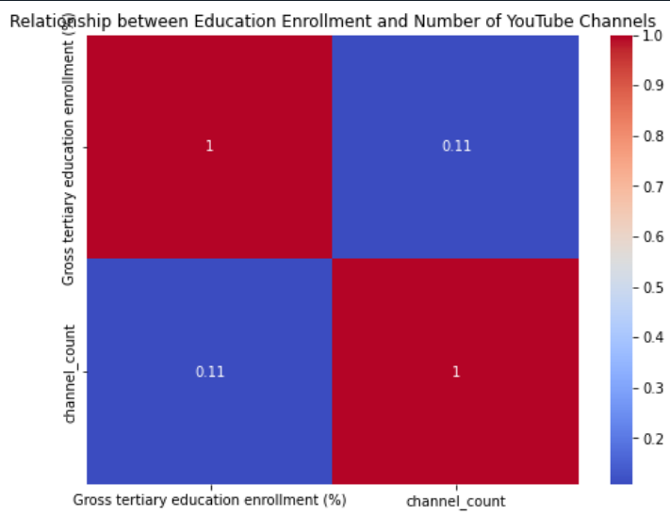
Is there a relationship between gross tertiary education enrolment and the number of YouTube channels in a country?
The correlation between Gross tertiary education enrolment and channel count is 0.11.
This indicates a positive correlation but with very less proportional change .This implies weak positive correlation.

Slide 16
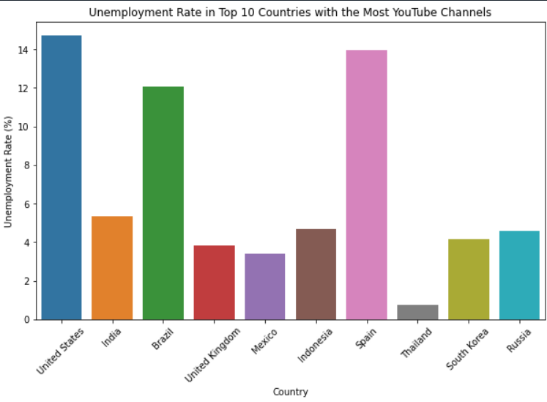
How does the unemployment rate vary among the top 10 countries with the highest number of YouTube channels?
United states holds the first position among the top 10 countries with highest number of YouTube channels.
It also possess high unemployment among its population

Slide 17
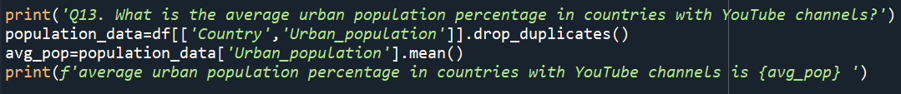
What is the average urban population percentage in countries with YouTube channels?

Slide 18
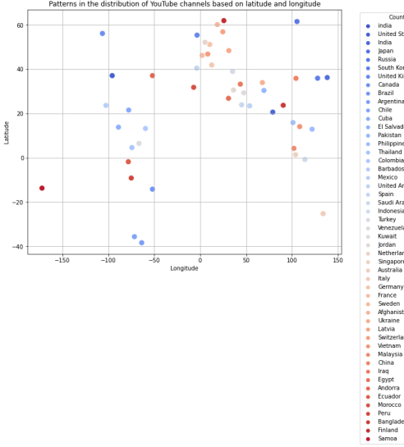
Are there any patterns in the distribution of YouTube channels based on latitude and longitude coordinates?
There are clusters at certain area indicating that YouTube channels are concentrated at some specific geographic areas.

Slide 19
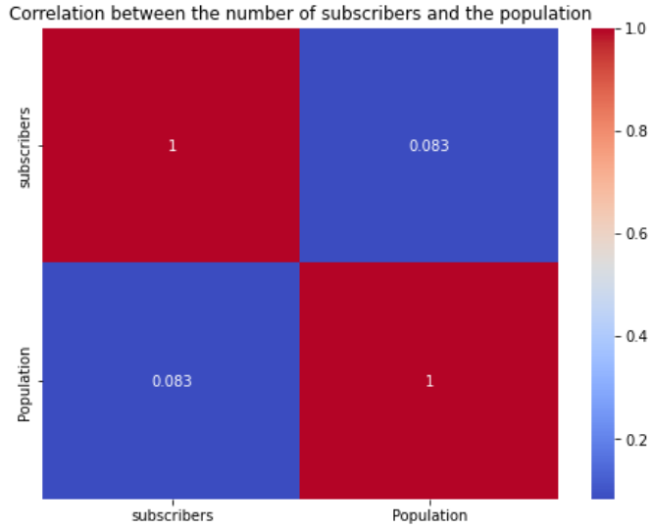
What is the correlation between the number of subscribers and the population of a country?
This is a weak positive correlation of 0.083 between the two variables Population and subscribers.

Slide 20
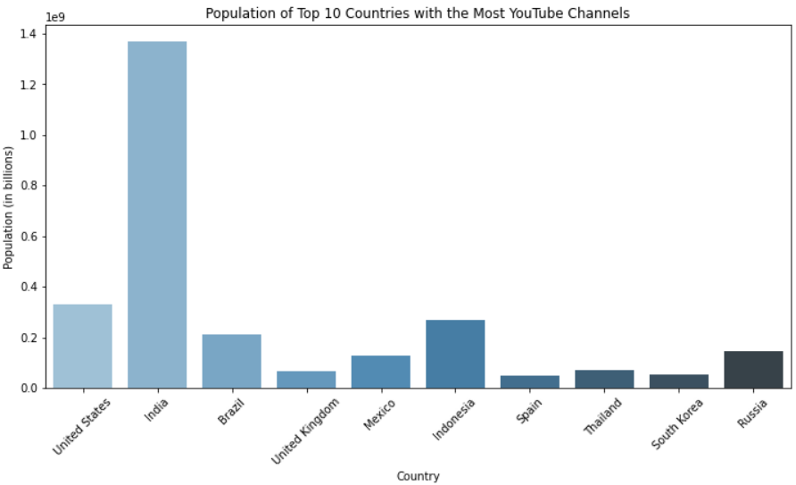
How do the top 10 countries with the highest number of YouTube channels compare in terms of their total population?
India has population of more than 1 billion and US has 328 million.

Slide 21
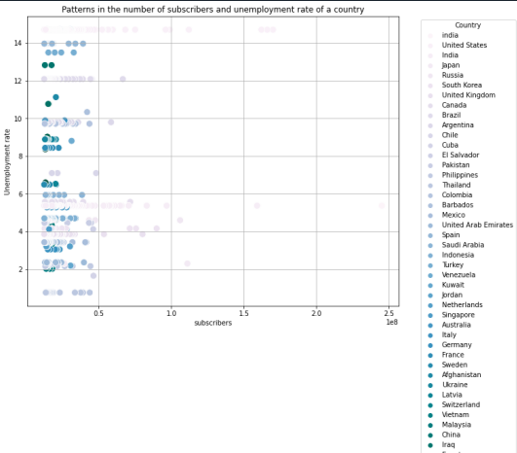
Is there a correlation between the number of subscribers gained in the last 30 days and the unemployment rate in a country?
There doesn't appear to be a strong correlation between the number of subscribers and the unemployment rate. The points are scattered across the plot, indicating that the number of subscribers does not consistently increase or decrease with the unemployment rate.

Slide 22
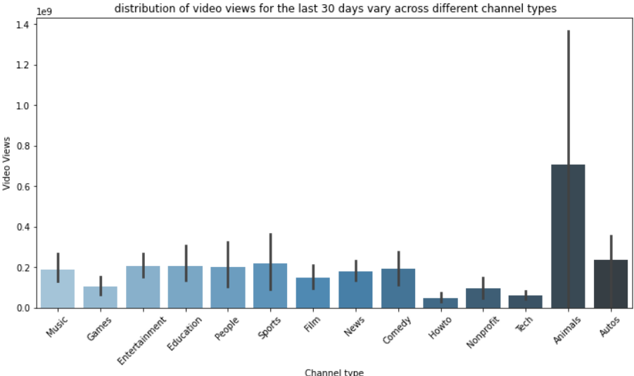
How does the distribution of video views for the last 30 days vary across different channel types?
Channel Type Performance:
High Views: Music, Entertainment, and Games channels have the highest number of views.
Medium Views: Education, People, Sports, and News channels have moderate viewership.
Low Views: Howto, Nonprofit, Tech, Animals, and Autos channels have the lowest number of views.

Slide 23
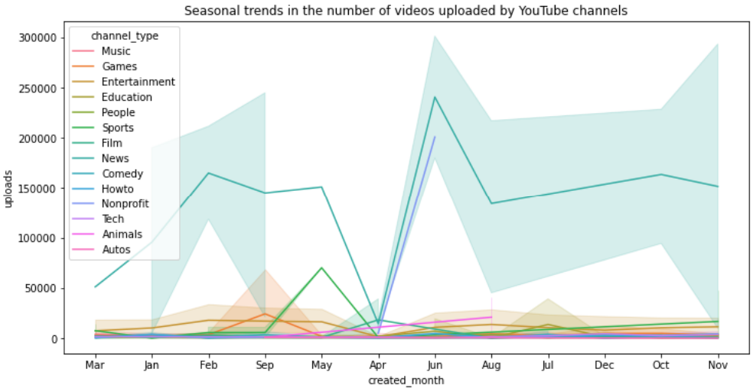
Are there any seasonal trends in the number of videos uploaded by YouTube channels (Quarterly Analysis)?
Overall Trend: There is a general increase in video uploads from March to May, followed by a decline and then another peak in December.
Music,Games,and Entertainment:These categories show consistent high upload numbers
throughout the year.

Slide 24
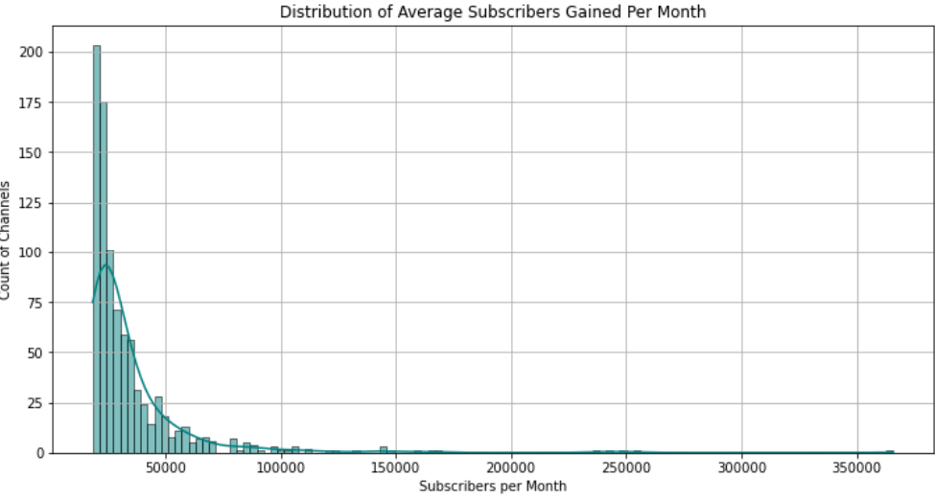
What is the average number of subscribers gained per month since the creation of YouTube channels till now?

